Slide 1

Analysis of Chicago Crimes Dataset
Product Overview Presentation
CSC 6740
Team 8

Slide 2
Team Members
Dhruv Gupta
Hsiu-Yuan Fan
Shinjini Srivastava

Slide 3
Project Overview
Analyze the Chicago Crimes dataset and find correlations in the elements that can be used for predicting crime and explore other features of the dataset

Slide 4

Overview

Slide 5
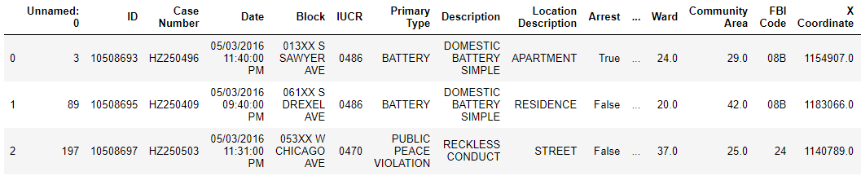
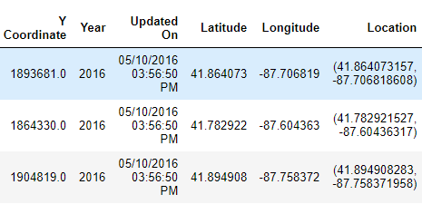
Data Set Snapshot: Crimes from 2012 to 2017
1.5 million rows
23 features

Slide 6
Data Cleaning
Identify Null values
Repeating Values
Highly Correlated Columns
Consistent Data Types

Slide 7
Null Values
Unnamed: 0 0
ID 0
Case Number 1
Date 0
Block 0
IUCR 0
Primary Type 0
Description 0
Location Description 1658
Arrest 0
Domestic 0
Beat 0
District 1
Ward 14
Community Area 40
FBI Code 0
X Coordinate 37083
Y Coordinate 37083
Year 0
Updated On 0
Latitude 37083
Longitude 37083
Location 37083
dtype: int64
Columns Dropped:
Unnamed
ID
Case Number
Location
X-coordinate
Y-Coordinate
Imputation
Location information is inferred from just longitude and latitude
Significant missing location information replaced by the mean of long / lat of Ward

Slide 8
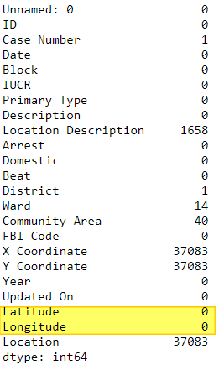
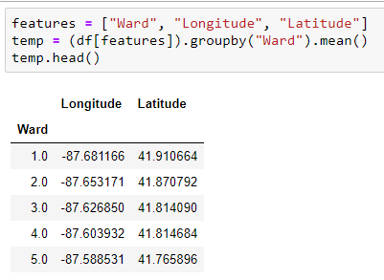
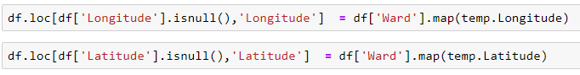
Imputation: Long / Lat
Calculate the mean Long / Lat for each ward
Build lookup table
For each missing Long Lat, look up the ward and replace the missing value with the value in look up table
Notes:
There were no fields with both missing Ward information and missing Long - Lat

Slide 9
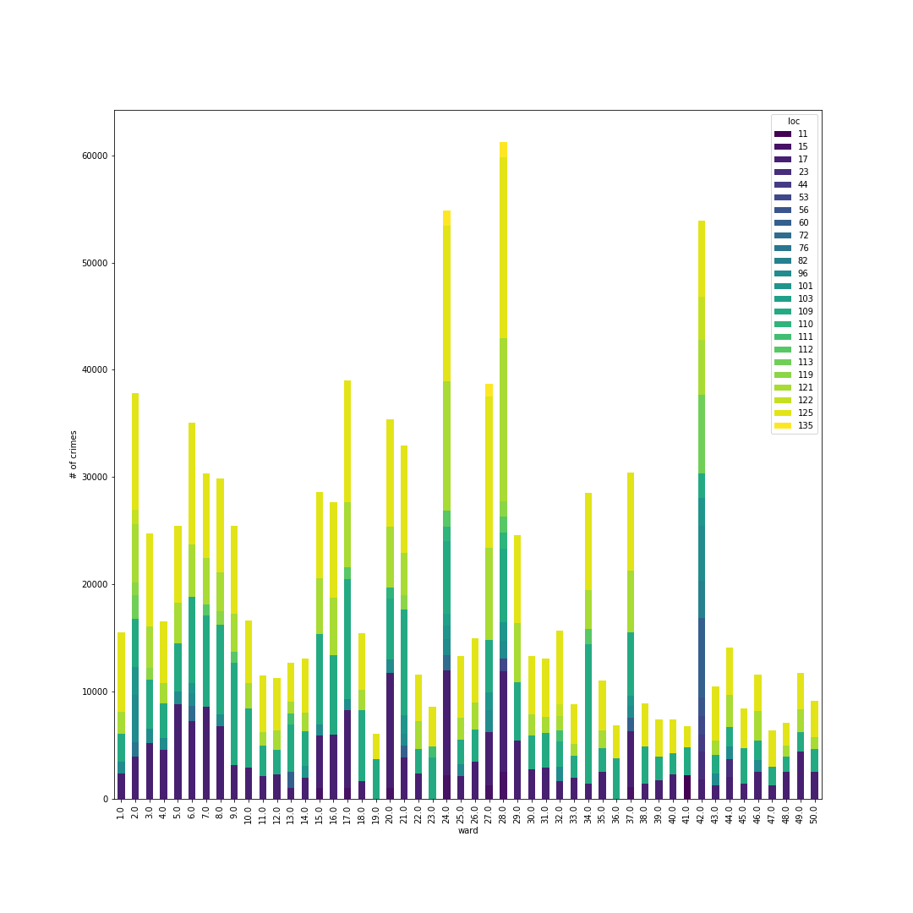
Significant Crime Location Distribution
Notes:
Crime types with count > 1000

Slide 10
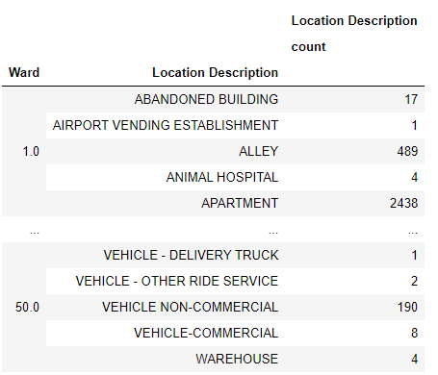
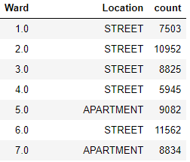
Imputation: Location Description
For each ward, the most occurring community area is calculated and kept in a table
For each entry with a missing community area:
Lookup the table with the ward as key and replace missing value
Notes:
This is important because otherwise all the replacements will be

Slide 11
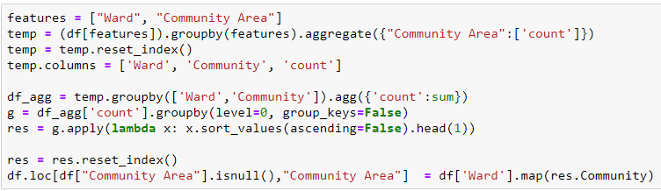
Imputation: Community Area
For each ward, the most occurring community area is calculated and kept in a table
For each entry with a missing community area:
Lookup the table with the ward as key and replace missing value
Other Imputed Columns: District

Slide 12
Exploratory Data Analysis
Rate of change of type of crime with respect to time over 5 year period
Change in # of crimes of a particular type wrt time of year
Change in the # of crimes with respect to the day of the week

Slide 13
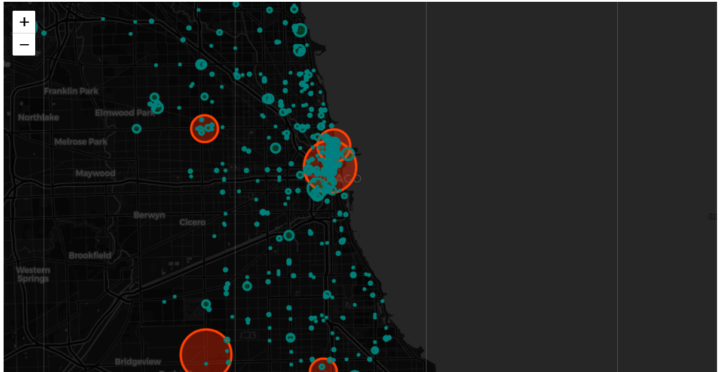

Slide 14
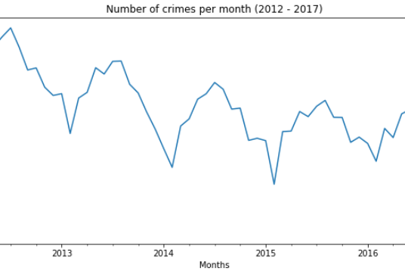
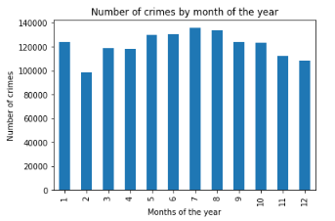
Crime is Cyclical: Lower during winter

Slide 15
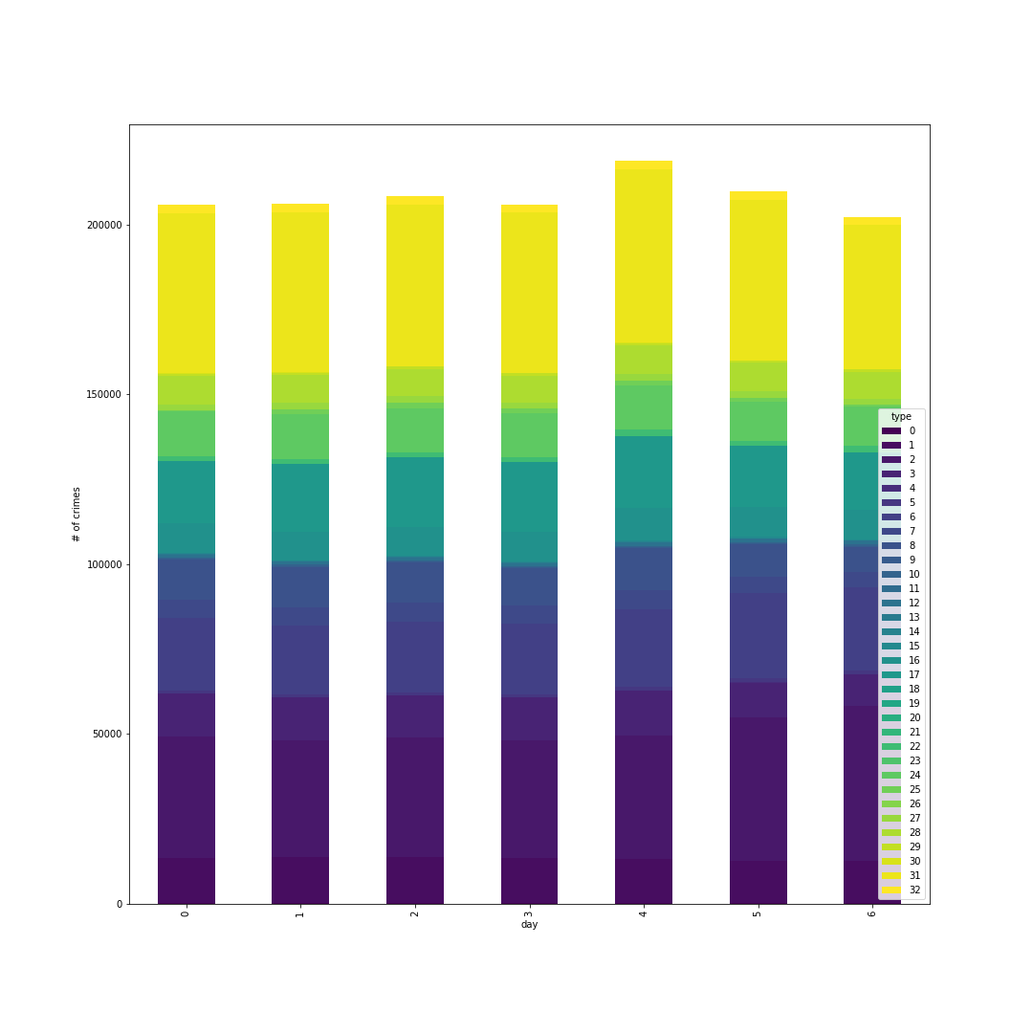
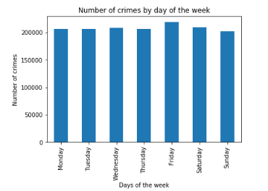
Crime doesn’t take a holiday: Crimes are independent of the day of the week

Slide 16
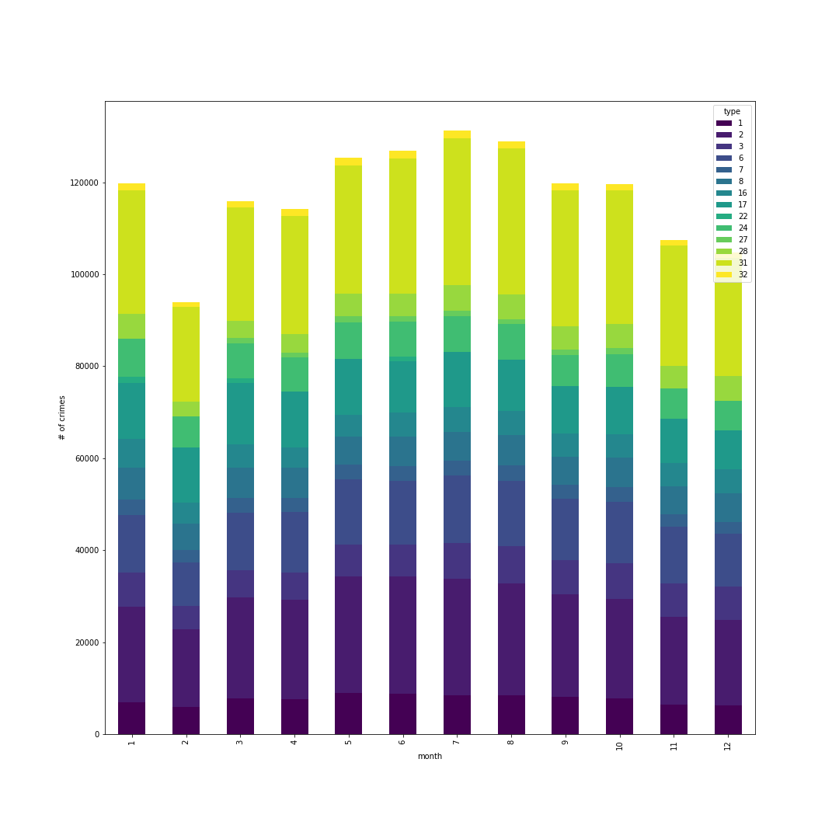
Crimes Per Month Breakdown

Slide 17
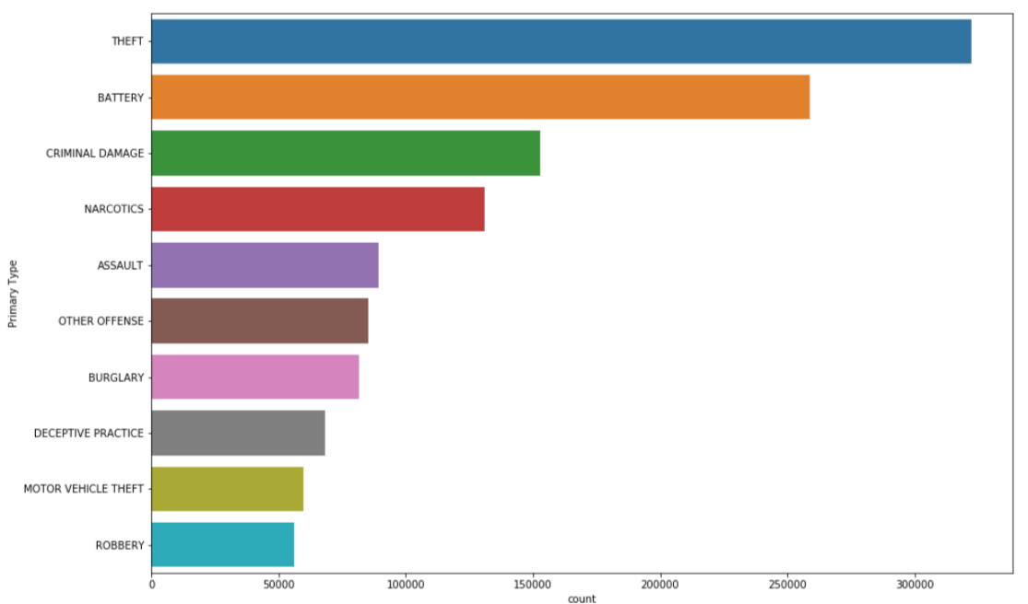
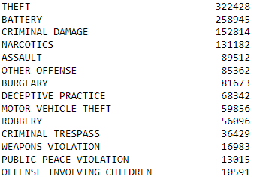
Most Common Crimes

Slide 18
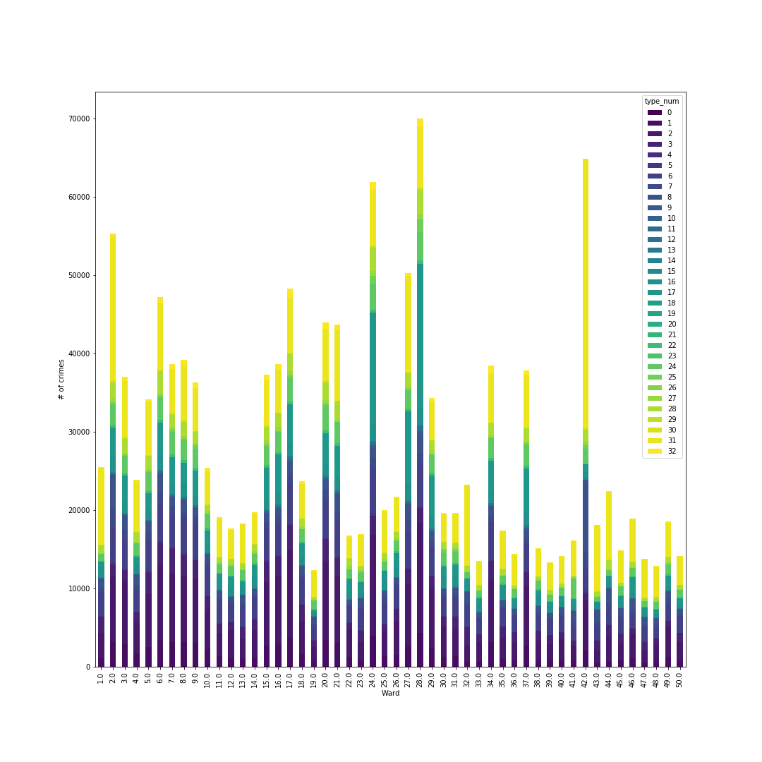
Crime Type distribution per Ward

Slide 19
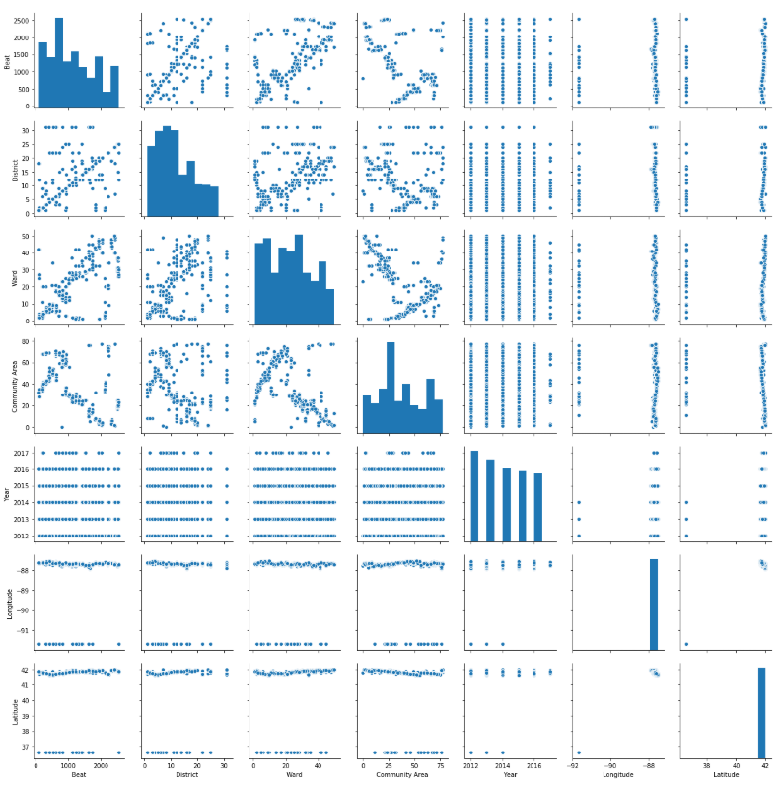
Checking correlations between columns

Slide 20
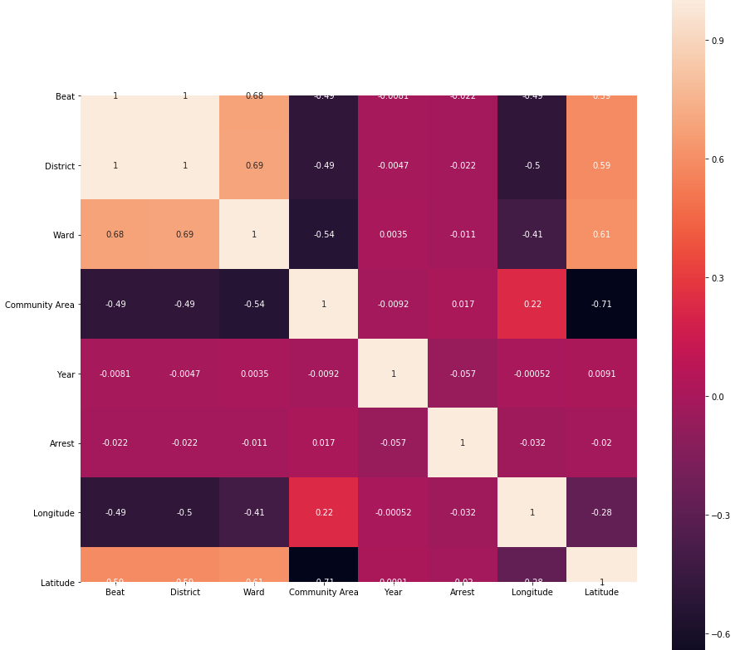
Heat Map
Notes:
Some Community areas are more prone to crimes and arrests

Slide 21
Algorithms Used
Principal Component Analysis
K means clustering
Naïve Bayes
Random Forrest

Slide 22
Principle Component Analysis
Principal components analysis (PCA) is one of a family of techniques for taking high-dimensional data, and using the dependencies between the variables to represent it in a more tractable, lower-dimensional form, without losing too much information.
Each principle component is a curve fitted to the data of all the features being reduced
Each PC represents the % of total variance of the model and reduces with each new PC

Slide 23
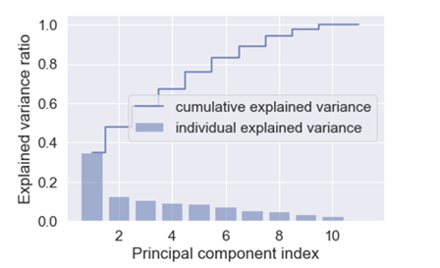
Principle Component Analysis
Variance: [0.38379316 0.12059172 0.10386811]

Slide 24
K means Clustering
Clustering is an unsupervised learning technique
Partitional Clustering
Insight about the internal structure of the data
Examine partitioning between different groups
Useful for knowledge discovery

Slide 25
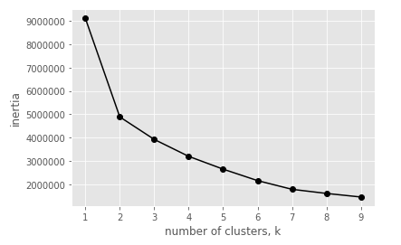
Finding Optimum number of clusters

Slide 26
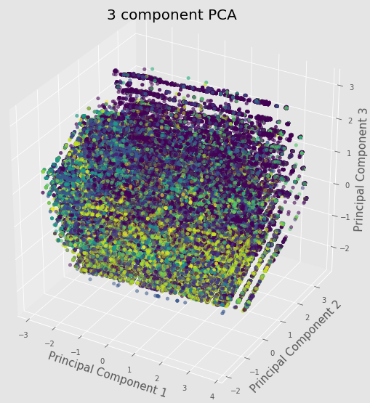
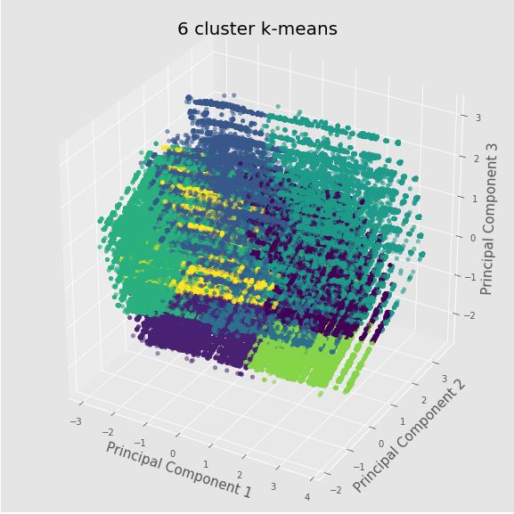
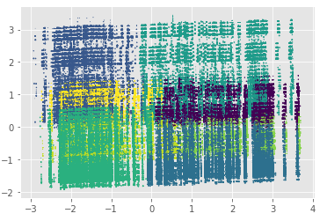
K means clustering

Slide 27
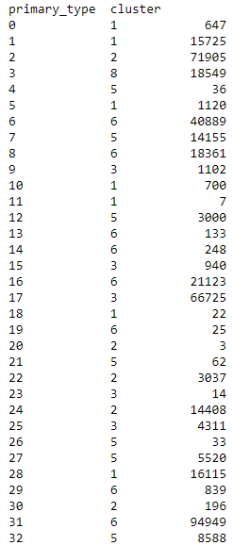
K means evaluated labels

Slide 28
Naïve Bayes Algorithm: What is Naïve Bayes Algorithm?
Naïve Bayes Algorithm is a classification technique derived from Bayes’ Theorem.
The assumption of this algorithm is that each feature in the class needs to be independently.
Notes:
https://www.analyticsvidhya.com/blog/2017/09/naive-bayes-explained/

Slide 29
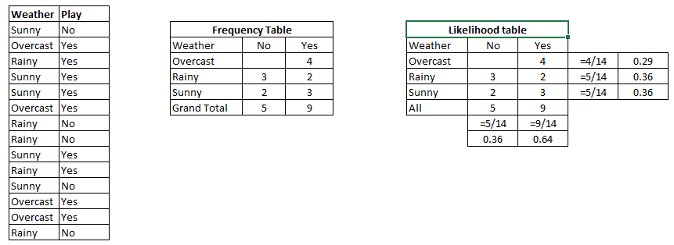
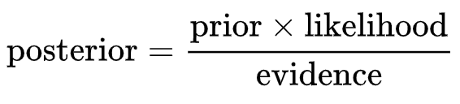
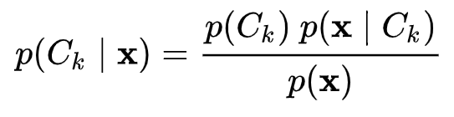
How Naïve Bayes algorithm works?
Notes:
Step 1: Convert the data set into a frequency table
Step 2: Create Likelihood table by finding the probabilities like Overcast probability = 0.29 and probability of playing is 0.64.
Step 3: Now, use Naive Bayesian equation to calculate the posterior probability for each class. The class with the highest posterior probability is the outcome of prediction.
Problem: Players will play if weather is sunny. Is this statement is correct?
We can solve it using above discussed method of posterior probability.
P(Yes | Sunny) = P( Sunny | Yes) * P(Yes) / P (Sunny)
Here we have P (Sunny |Yes) = 3/9 = 0.33, P(Sunny) = 5/14 = 0.36, P( Yes)= 9/14 = 0.64
Now, P (Yes | Sunny) = 0.33 * 0.64 / 0.36 = 0.60, which has higher probability.
https://www.analyticsvidhya.com/blog/2017/09/naive-bayes-explained/

Slide 30
What are the Pros and Cons of Naïve Bayes?
Pros:
Cons:
Easy and fast to predict the data
Input does not need to be numerical variables
The assumption of independent predictors is hard to find in real life
Zero Frequency situation happens if the categorical variable has a category not observed in training data set.
Notes:
https://www.analyticsvidhya.com/blog/2017/09/naive-bayes-explained/

Slide 31
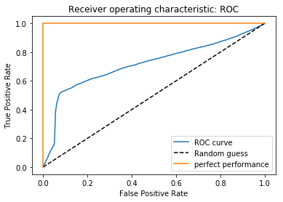
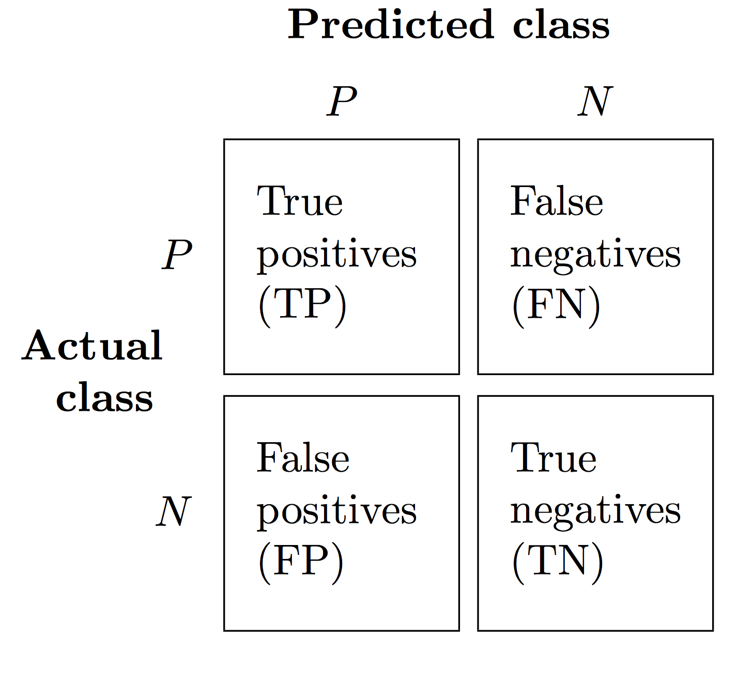
Reciever Operating Charecteristic Curve (ROC)
Useful when predicting probability of a binary outcome.
ROC Curves summarize the trade-off between the true positive rate and false positive rate for a predictive model using different probability thresholds.
ROC curves are appropriate when the observations are balanced between each class, whereas precision-recall curves are appropriate for imbalanced datasets.

Slide 32
Naïve Bayes Results
Precision = TP/(TP+FP)
= 0.8438
Recall = Sensitivity = TP/(TP+FN)
= 0.9208
Specificity = TN/(TN+TP)
= 0.1662
Accuracy: 0.8157
Notes:
Receiver Operating Characteristic (ROC) graphs are useful tools to select models
for classification based on their performance with respect to the FPR and TPR,
which are computed by shifting the decision threshold of the classifier.

Slide 33
Random Forest
Random Forrest is an ensemble learner which can be used for Classification and Regression.
Ensemble learners are composite ML tools which use multiple different learners in combination
Random Forest is composed of multiple decision trees
Each tree in the Forest is built from a different combination of columns
Finally for classifying data, each new data element runs through each tree and the mode of results from all trees is returned => Bagging [Bootstrap Aggregation]

Slide 34
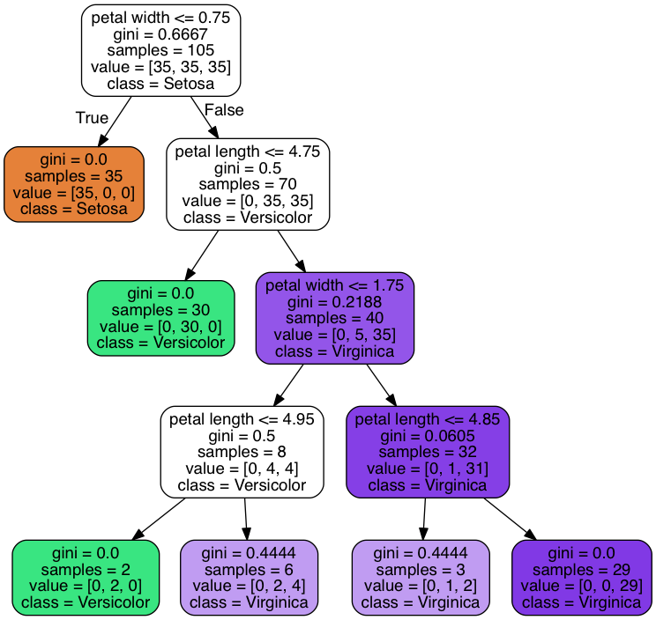
Decision Tree
Learning the simplest decision tree is an NP complete problem
Greedy Heuristics must therefore be used to build a decision tree
Start with empty tree
Choose best feature to split tree
Recurse
Best feature for split
Good split increases certainty about classification after split = Reduces Entropy
Information Gain = Entropy before split – Entropy after split
Notes:
Tree Building Summary
If output values are all same in the dataset, return leaf node
If all inputs are same, return leaf node that predicts the majority of the output
Otherwise find attribute with max information gain

Slide 35
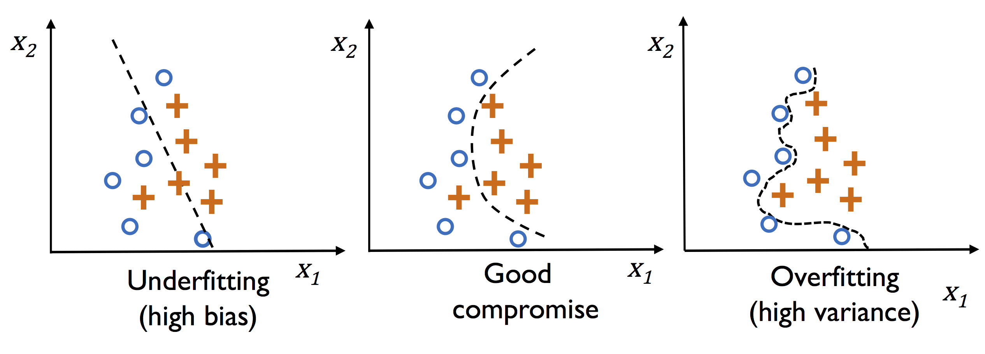
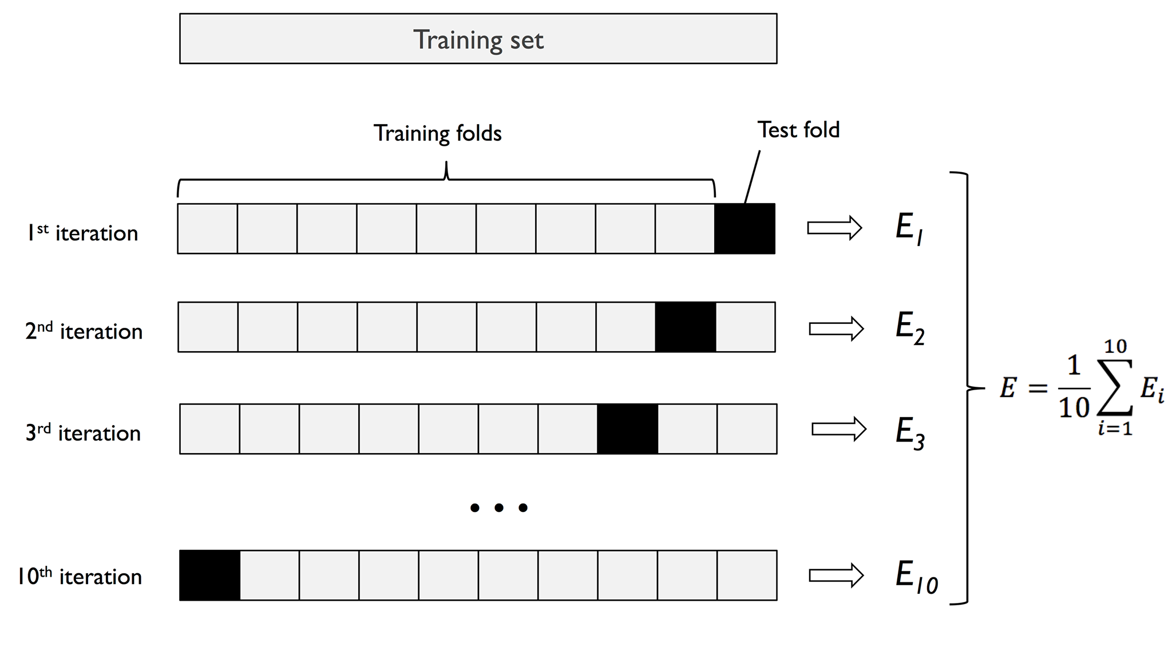
Random Forrest k fold Accuracy
Measuring accuracy with k fold means and 20 trees
# of folds | Accuracy
3 | 0.965700934
4 | 0.967702962
5 | 0.96951049
6 | 0.970040898
7 | 0.970358613
8 | 0.970568539
9 | 0.970443172
10 | 0.970755205
11 | 0.970612229
12 | 0.970671393
13 | 0.970797452
14 | 0.970910198

Slide 36
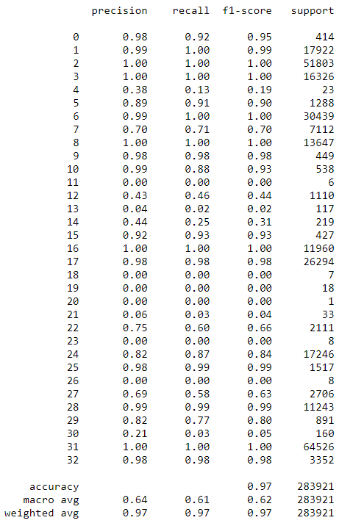
Random Forest Results

Slide 37
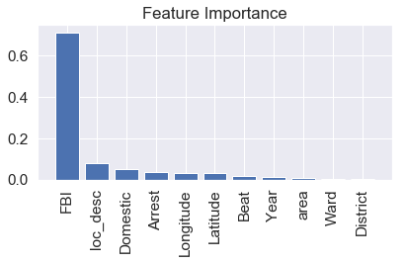
Random Forest Analysis

Slide 38
Performance Comparison
Classifier | Accuracy
Naïve Bayes | 79 %
Random Forest (1 tree) / Decision Tree | 93 %
Random Forest (2 tree) | 91 %
Random Forest (15 trees) | 97% 98% (with cluster targets)
Random Forest (15 trees) without FBI | 14 %
Random Forest w/o FBI w/ human assigned clusters in target variable | 46 %
Random Forest w/o FBI w/ K means assigned groups of final variable | 57 % (15 trees)

Slide 39
Conclusion
It is possible to predict the type of crime based on an input vector with location information
From Data Visualizations, Police can see the trend of each crime in the city
Based on visualization, Police can decide how to respond to crime, e.g. Increase patrols in areas where large amount of street crime
People can use these models to supplement property data to value house prices

